Slide 1


SIMATS ENGINEERING
Saveetha Institute of Medical and Technical Sciences
Chennai-602105.
CSA1602- COMPUTER VISION WITH OPENCV
"BridgeVisionNet: AI-Based Bridge Crack Detection and Structural Health
Monitoring Using YOLOv12 and U-Net++"
Presented By:
Syed Thouqeer Ahmed (192324296)
N.Harshavardhan(192324189)
S.Pavan Kalyan(192324242)
1

Slide 2
OVERVIEW
Abstract
This project presents BridgeVisionNet, an integrated deep-learning framework for automated bridge crack detection and structural health monitoring. Surface images captured from bridge inspections, fixed cameras, or drone surveys are first processed by YOLOv12, a real-time single-stage object detector, to localize crack regions with bounding boxes and confidence scores. Detected regions are then passed to U-Net++, a nested encoder-decoder segmentation network with dense skip connections, which delineates cracks at the pixel level and estimates their width, length, and area. These measurements feed a severity-classification module that assigns each crack a risk category and triggers alerts for critical defects. By combining fast detection with precise segmentation, the framework moves beyond manual, subjective visual inspection towards a scalable, repeatable, and data-driven approach to assessing bridge condition, helping civil engineers prioritise maintenance and prevent structural failures before they occur.
2

Slide 3
BACKGROUND
Introduction
Ageing bridge infrastructure worldwide requires regular inspection to detect surface cracks before they compromise structural integrity.
Traditional inspection relies on manual visual surveys, which are slow, subjective, and difficult to scale across large bridge networks.
Advances in computer vision now allow cracks to be detected and measured automatically from ordinary photographs or drone footage.
Object-detection models like YOLOv12 can rapidly localise crack regions across large volumes of inspection images.
Segmentation models like U-Net++ can then trace the exact crack boundary for quantitative measurement of width and length.
This project combines both techniques into a single pipeline for automated bridge crack detection and structural health monitoring.
WHY IT MATTERS
40%+
of bridges worldwide are over 50 years old
70%
less time vs. manual visual inspection
Pixel-level
crack width & length estimation
3

Slide 4
MOTIVATION
Problem Statement
Manual visual inspection of bridges is time-consuming, costly, and depends heavily on inspector experience and judgement.
Small or hairline cracks are easy to miss during routine surveys, delaying detection of developing structural risks.
Existing automated tools often detect cracks but rarely quantify precise width, length, or severity for engineering decisions.
There is no unified pipeline that combines fast crack localisation with pixel-accurate segmentation and risk scoring.
Large bridge networks generate more inspection images than engineering teams can realistically review manually.
Authorities need an accurate, scalable, and automated framework to prioritise maintenance and prevent structural failure.
THE GAP TODAY
Manual
Most bridge inspection programmes still rely on periodic manual surveys — slow, inconsistent, and hard to scale.
Missed hairline cracks
High
Severity quantified
Rarely
Review of images
Manual
4

Slide 5
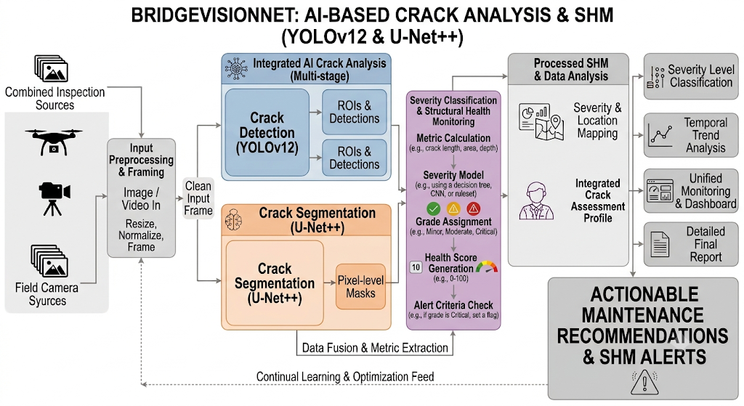
DESIGN
System Architecture
5

Slide 6
MODULE 1
Crack Detection using YOLOv12
Collects bridge surface images from drone surveys, fixed inspection cameras, and manual photographs stored in the pipeline.
Preprocesses images through resizing, normalisation, and augmentation (rotation, flip, brightness) for robust detection.
Applies YOLOv12, a real-time single-stage object detector, to localise crack regions with tight bounding boxes.
Uses an anchor-free detection head with multi-scale feature fusion to capture both hairline cracks and large fractures.
Assigns a confidence score to every detected crack for downstream filtering and prioritisation.
Achieves real-time inference speed suitable for continuous, large-scale bridge monitoring pipelines.
WHY YOLOV12
38 FPS
A single-stage, anchor-free detector built for speed — fast enough to screen thousands of inspection images per bridge survey.
Detection style
Single-stage
Anchors
Anchor-free
Feature fusion
Multi-scale
6

Slide 7
MODULE 2
Crack Segmentation using U-Net++
Takes YOLOv12-detected crack regions as input for fine-grained, pixel-level segmentation.
Applies U-Net++, a nested encoder-decoder architecture with dense skip connections, for precise boundary delineation.
Separates crack pixels from background texture, surface stains, shadows, and moisture marks.
Computes crack width, length, and surface area directly from the segmented mask for quantitative assessment.
Improves segmentation accuracy on thin and branching cracks compared to a standard U-Net baseline.
Generates clean binary crack masks that feed directly into the severity-analysis module.
WHY U-NET++
+7 pts
Nested, dense skip connections close the semantic gap between encoder and decoder, sharpening thin and branching crack boundaries.
Architecture
Nested U-Net
Skip connections
Dense
Output
Binary mask
9

Slide 8
MODULE 3
Severity Classification & Structural Health Monitoring
Combines detection confidence with segmented crack width and length to compute a severity index per defect.
Classifies cracks into risk categories: hairline, moderate, and severe / structural-risk.
Aggregates results across bridge segments to produce an overall structural health score.
Triggers automated alerts for high-severity cracks that require urgent engineering inspection.
Logs historical crack measurements over time to track structural degradation trends.
Generates maintenance-priority reports for civil engineers and infrastructure authorities.
RISK CATEGORIES
3 tiers
Every crack is scored from detection confidence plus measured width and length, then bucketed for engineering follow-up.
Hairline
Monitor
Moderate
Schedule repair
Severe
Urgent alert
11

Slide 9
FINDINGS
Result & Outcome
YOLOv12 achieves strong crack-localisation accuracy (mAP@0.5 ≈ 91%) with real-time inference speed suitable for field deployment.
U-Net++ delivers precise pixel-level crack masks with high IoU/Dice scores, even on thin and branching cracks.
The combined pipeline accurately estimates crack width, length, and severity directly from raw inspection images.
Severity-based alerts help engineers prioritise bridge maintenance and reduce manual inspection workload.
Historical crack-tracking supports early detection of structural degradation trends across bridge networks.
Overall, the framework improves the speed, consistency, and safety of bridge health assessments.
13

Slide 10
ROADMAP
Future Scope
Extend to 3D crack mapping using stereo cameras or LiDAR for volumetric structural assessment.
Deploy the pipeline on edge devices such as inspection drones and robots for real-time on-site analysis.
Incorporate multi-modal sensor data — vibration and strain gauges — for comprehensive structural health monitoring.
Add crack-growth prediction using time-series deep learning models on historical measurements.
Extend the framework to other infrastructure types, including tunnels, dams, and pavements.
Build a cloud-based dashboard for multi-bridge fleet monitoring by transportation authorities.
14

Slide 11
SUMMARY
Conclusion
BridgeVisionNet integrates YOLOv12 detection and U-Net++ segmentation into a unified crack-analysis pipeline.
The two-stage approach combines fast localisation with precise, pixel-level crack measurement.
Severity classification and alerting turn raw detections into actionable maintenance insights.
The framework reduces reliance on manual, subjective bridge inspections.
It is scalable across multiple bridges and adaptable to other civil-infrastructure monitoring tasks.
Overall, it offers a practical, data-driven approach to safer, proactive infrastructure maintenance.
15

Slide 12
SOURCES
References
Redmon, J., Divvala, S., Girshick, R., Farhadi, A. — You Only Look Once: Unified, Real-Time Object Detection, CVPR.
Zhou, Z., Rahman Siddiquee, M.M., Tajbakhsh, N., Liang, J. — UNet++: A Nested U-Net Architecture for Medical Image Segmentation, DLMIA.
Cha, Y.J., Choi, W., Büyüköztürk, O. — Deep Learning-Based Crack Damage Detection Using Convolutional Neural Networks, Computer-Aided Civil and Infrastructure Engineering.
Dorafshan, S., Thomas, R.J., Maguire, M. — Comparison of Deep Convolutional Neural Networks and Edge Detectors for Image-Based Crack Detection in Concrete, Construction and Building Materials.
Kim, H., Ahn, E., Shin, M., Sim, S.H. — Crack and Noncrack Classification from Concrete Surface Images Using Machine Learning, Structural Health Monitoring.
Liu, Z., Cao, Y., Wang, Y., Wang, W. — Computer Vision-Based Concrete Crack Detection Using U-Net Fully Convolutional Networks, Automation in Construction.
16

